Slide 1



Kelly’s Kids
2nd Grade
Welcome Parents!
-Please read your child’s letter to you in their LA Journal and write a message back.
- Feel free to leave messages in random spots in their other journals.
-You may keep the papers on the desk, but leave the journal!
-Check out the table to see if there is a way you can help us out this school year.

Slide 2
Kelly’s Kids
2nd Grade
Welcome Parents!
Thank you for coming to the Kelly’s Kids Open House!

Slide 3
Kelly’s Kids
Family!

Slide 4
All About Mrs. Kelly
Top 10 list all about me:
1. My real name is Courtney Kelly.
2. I have been married for 18 years to Scott Kelly.
We have two little (big) boys that go to Lassiter & Mabry . Kade is in 9th grade and Rennen is in 7th grade.
4. Although I don't have a little girl, I have a sweet pup named Clover who is a 5 year old Poodle/Bichon mix.
5. I love to go on mission trips through Blue Skies to serve families who have a child with cancer. We will be going back to Blue Skies during Sept. Break.

Slide 5
All About Mrs. Kelly
10 list all about me:
6. I love planning parties (and was actually the Party Planner Director for our Blue Skies mission trip last year.)
7. I grew up in NY where I attended elementary, middle, and high school.
I went to college at:
Augusta State University (Undergrad in teaching)
Kennensaw State University (Masters in Educational Leadership), Lincoln Memorial University (Specialist in Educational Leadership)
9. My hubby is an assistant principal/Athletic Director at Lassiter High School in Marietta.
10. This is my 19th year teaching and it is going to be an amazing year!

Slide 6
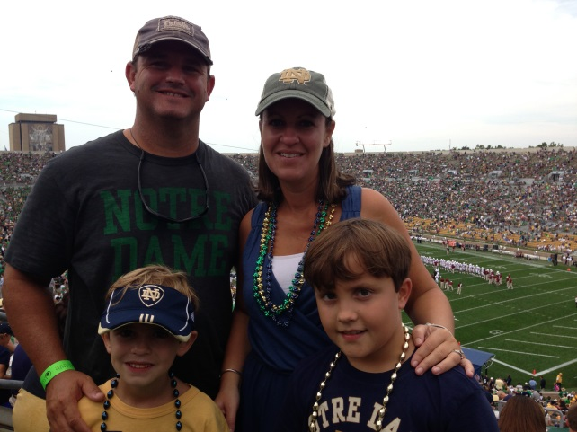
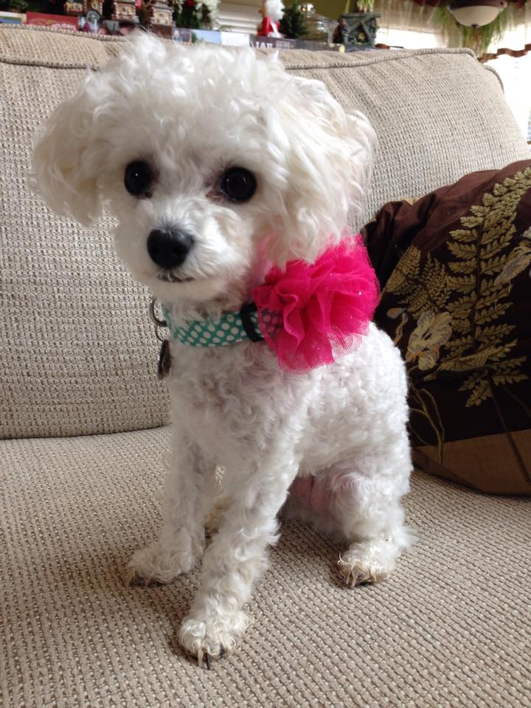
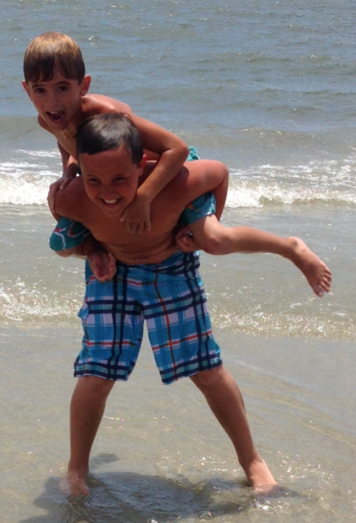
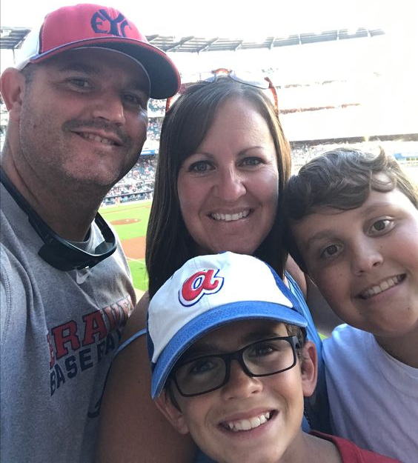
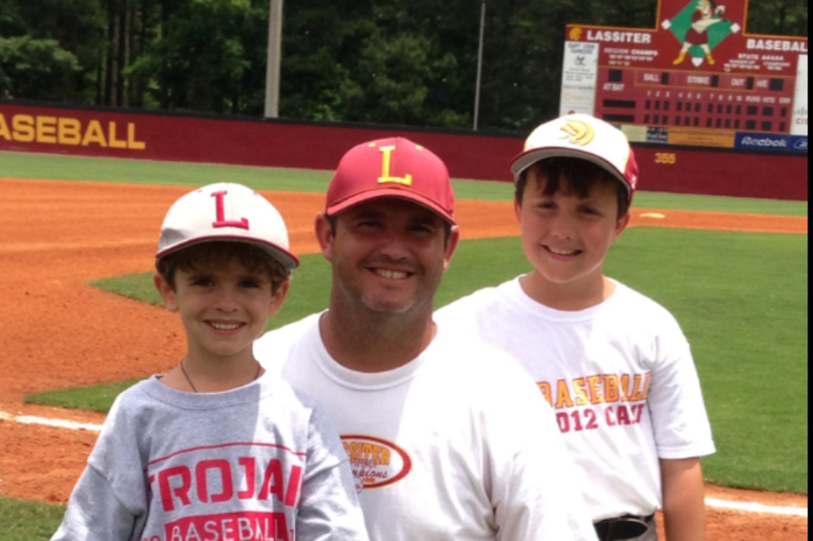

Slide 7
Mrs. Kelly’s
Daily Schedule
7:15-7:50 Arrival, Morning Work
7:50-8:00 Announcements/Attendance
8:00-8:15 STEM
8:15-9:00 Specials
Day 1 – Art/Day 2 – P.E. /Day 3 – Music/
Day 4 – P.E. /Day 5 – STEM Lab/ Day 6- P.E.
9:00-9:25 Bathroom/snack/story/check homework and
pass out new homework
9:25-11:19 Daily 5 Literacy Block/Writer’s Workshop
11:19-11:27 Clean-/Restroom
11:30-12:00 Lunch/Table 12/13
12:00-12:10 Number Talks
12:10-1:10 Daily 3 Guided Math
1:10-1:40 Restroom/Recess
1:40-2:00 Integrated Science/Social Studies/Health
2:00-2:15 Read Aloud/ Pack
2:15-2:30 Afternoon Announcements/Dismissal

Slide 8
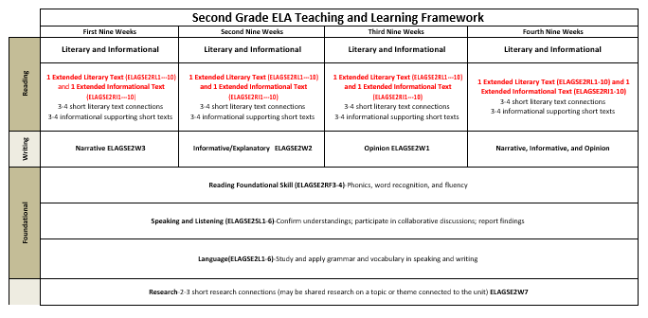
Year at a Glance

Slide 9
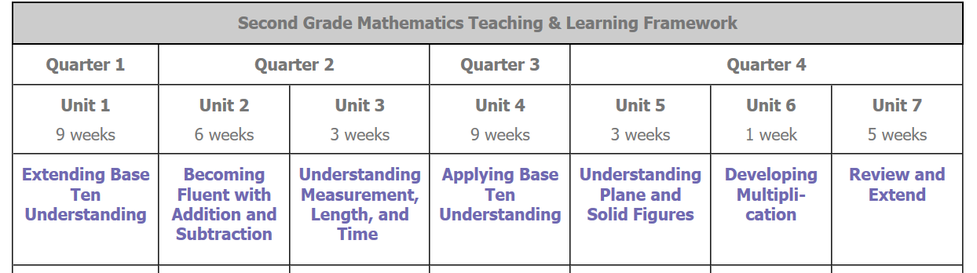
Year at a Glance

Slide 10
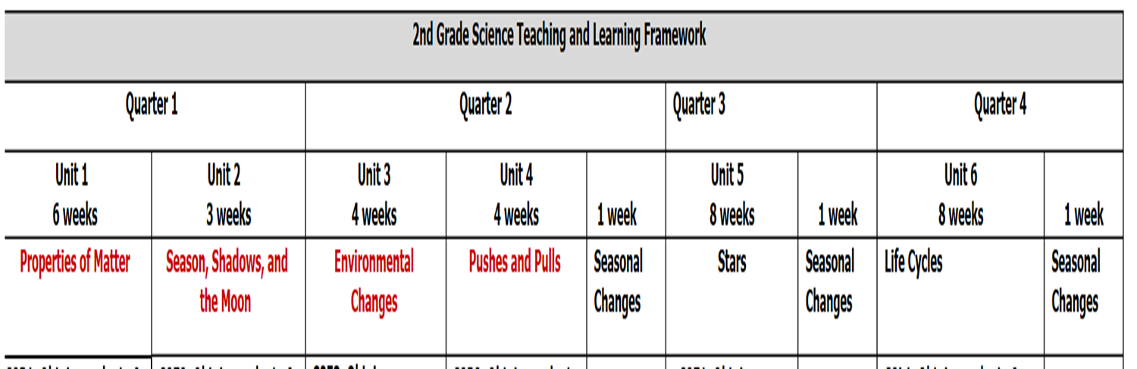
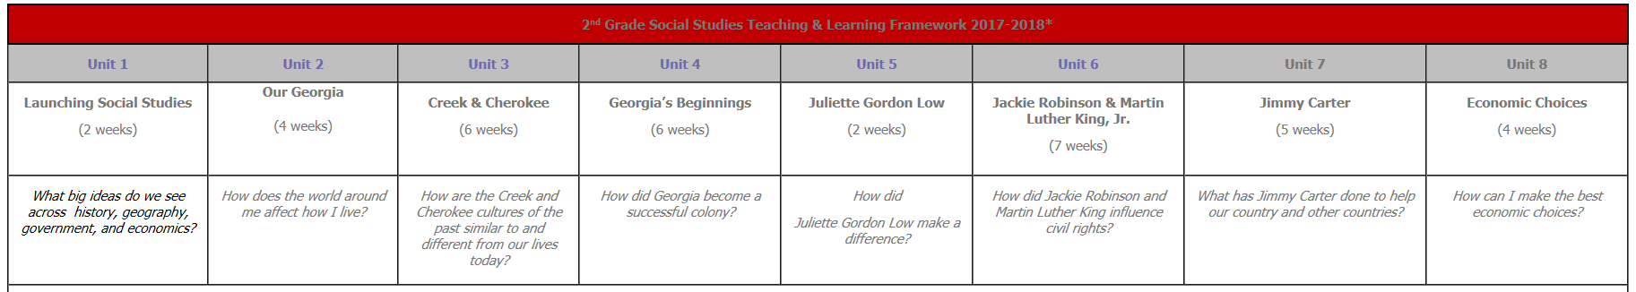
Year at a Glance

Slide 11
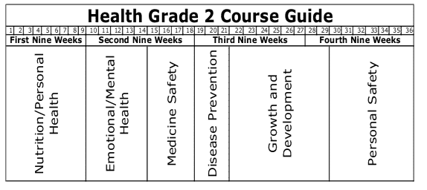
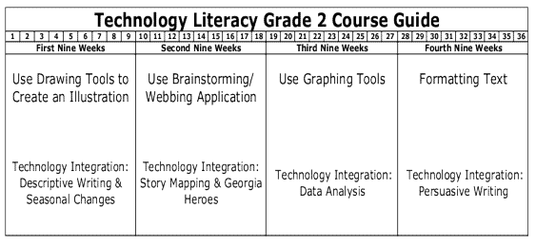
Year at a Glance

Slide 12
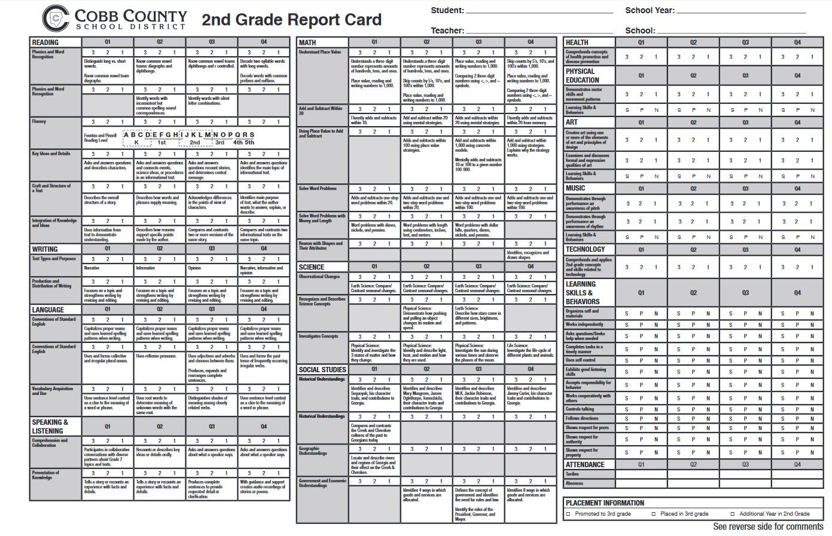

Slide 13

Love and Logic

Slide 14
Behavior Checkpoints
1. Organizes self and materials
2. Works independently
3. Asks questions/Seeks help when needed
4. Completes tasks in a timely manner
5. Uses self-control
6. Exhibits good listening skills
7. Accepts responsibility for behavior
8. Works cooperatively with others
9. Controls talking
10. Follows directions
11. Shows respect for peers
12. Shows respect for authority
13. Shows respect for property

Slide 15
2nd Grade
Incentives
Gold Tickets and Ford Friday
B.U.G.S. Tickets
Table Cubes
Class Compliments Celebrations

Slide 16
Birthday’s
We love to celebrate birthday’s!
-You are welcome to send in or bring a treat to share during lunch.
-Meet us at 11:30 in the front hall or in the small cafeteria.
-We have 22 students and we do have a
TREE NUT allergy.
-Please make sure to celebrate those summer birthday’s! Celebrating their half birthday’s work great!

Slide 17
2nd Grade
Field Trips
*Tellus Museum-Science Standards
*Fire Safety- Health/Safety Standards
*Performing Arts- Fine Arts

Slide 18
Communication
Between Home & School
***Teacher Texts through BLOOMZ
(Please join using the form on your desk,)
Agendas
Weekly Folders
Reading Logs
Webpages/Blog
Group Emails
School-wide phone messages

Slide 19
Morning Work/Homework
Morning Work is a fun way to start our day-
(Made It Monday, Tell Them Tuesday, Thankful Thursday, Finish It Friday.)
Homework is intended to reinforce understanding and build confidence. This doesn’t always happen, so if you ever have craziness, just write a note in the agenda and skip it!

Slide 20
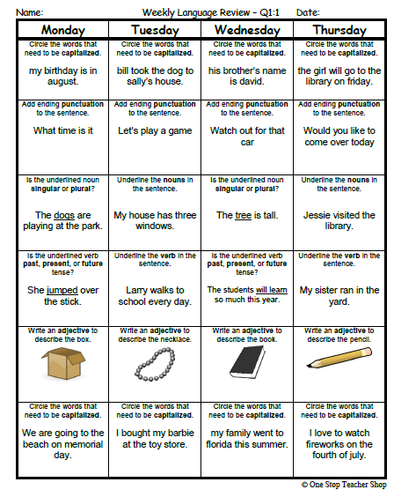
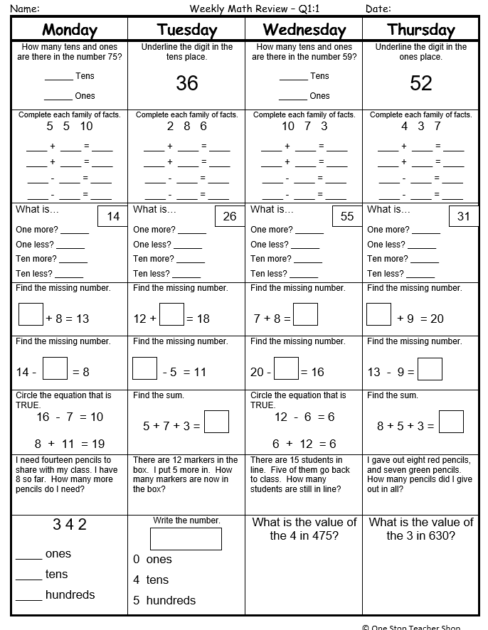
Morning Work/Homework

Slide 21
Spelling
Students will receive words according to their spelling skill level.
15 new words every week; 10 phonics- related words and 5 High Frequency Words.
High Frequency Words will be cumulative throughout the year.
Spelling lists will be found in their agenda.

Slide 22
ATTENDANCE PROTOCOL
(Board Administrative Rule JE)
Excused Absences:
Excused absences are defined by law in the State Board of Education Rules (per Cobb
Regulation JB). Absences from school are excused for the following:
• When personally ill and attendance in school would endanger their health or the health of others
• When there is a serious illness or death in the immediate family
• On special and recognized religious holidays observed by their faith
• When mandated by order of governmental agencies.
Please note that documentation regarding the reasons for the child’s absence must be received within 3 days. Also, the principal may ask for additional medical or other documentation to verify that absences are excused, particularly when more than three (3) absences have been accumulated during the semester. It is always best practice to send in a doctor’s note IF your child has been out sick AND has seen a doctor.
All absences, including religious holidays, must be accompanied by a note from the parent or guardian regarding the reason for the absence.

Slide 23
ATTENDANCE PROTOCOL
(Board Administrative Rule JE)
Unexcused Absences:
Please send in a note explaining your child’s absence. The notes are given to the child’s teacher and then sent to the office for coding. When no note is received, the absence defaults to UNEXCUSED in our computerized system after 3 days.
• At three (3) unexcused absences teachers will communicate with parents regarding student attendance via e-mail, phone, parent conference or postcard.
• At five (5) unexcused absences each school will utilize computer generated contact through one of the following: Telephone call, letter, and/or email.
• At seven (7) unexcused absences a School Social Work referral will be generated byprincipal or principal designee listing specific school-based interventions (telephone calls, letters, conferences, etc.) that have occurred prior to making the referral.

Slide 24
Safety
We are sadly at a time where we have to address school safety for our students. Ford LOVES our parents, all you do for us, & having you here, but please note-
-Our building and classroom doors will be locked at all times.
-Our school is requesting that we do not have any adults who are not staff (unless you are here to volunteer) walking through our building. This includes morning arrival and afternoon dismissal.
-The office can handle any needs you may have or any deliveries to our classroom.
-The Cobb School Police will be auditing all schools. Officers in street clothes or different uniforms will be trying to walk our building. They will be timing the staff to see how long it takes one of us to stop them and direct them back to the office.
-Please try not to get frustrated if the staff questions you at any time.

Slide 25
Safety
•Our building and classroom doors will be locked at all times.
•Upon arrival, ring the front doorbell and look into the camera. Please remove sunglasses and refrain from cell phone use at the camera. You may be questioned about the nature of your visit and asked to provide ID.
•Please do not hold the door open for other visitors and do not let other visitors in when you exit the building. Each visitor must ring the bell for entry into the building.
•Once you enter the building, report to the front office or please sign in at the computer in the front lobby. Please wear your visitor sticker at all times. Our staff has been trained to question any adult in the building not wearing a CCSD badge or visitor sticker.
•We request that no outside adults walk the halls of the building.

Slide 26
Safety
•The office can handle any needs you may have or deliveries to your child.
They will direct you to the cafeteria if you are bringing a forgotten lunch to school.
The Cobb County School District Police department will be conducting safety audits at all schools. We are fortunate to have a highly trained department providing support to all of the CCSD schools.

Slide 27
Safety
Another safety concern is for those students who arrive and leave by car. Please see the list below that outline our procedures for car line:
•Students may arrive beginning at 7:15am. Someone from the staff will be outside to ensure supervision starting at this time.
•Drivers should pull forward as directed. The front car should pull all the way up to the sign.
•Children should exit the car on the right side of the car. They should never exit on the left and walk around the car. In the afternoon, children must enter the car on the right side. They may not walk around the car to enter on the left. We realize this is more complicated for some of you with car seats or booster seats. We appreciate you making needed changes in order to allow students to enter and exit your vehicle safely.

Slide 28
Safety
•Drivers should have child safety locks off.
•Teachers are not to open car doors.
•If your child has trouble getting out of the car, please park your car in the parking lot and walk your child into the building.
•Never go around another car in front of you in car line unless directed by staff member and never in the front drive by the flagpole.
•Please wait until your car door is closed and your child is safely on the sidewalk before driving away.
•We have staff members directing traffic in the morning and afternoons. Always be aware and follow their directions to ensure their safety. During times of inclement weather, we will not have someone directing traffic. Please be patient and understand that the car line will move much more slowly on those days.

Slide 29
Safety
•Our car line is a “Cell Phone Free” zone.
•When waiting in car line in the afternoon for dismissal to begin, please remember our carline, parking lot and driveway are all a “No Idle Zone”.
•If your child is a car rider and you walk up to pick up your child inside the building during dismissal, you can meet them in the gym at 2:25. If you walk through the front hall to the gym, please remember to sign in at the computer and get a name tag.
With your help, we can protect our students at all times – from arrival through dismissal.
We appreciate your understanding, help with these changes and your continued support of our school.

Slide 30
Thank you for your time
and effort in enriching our classroom.
Please take a moment to sign up to volunteer at Ford.
Be sure to join PTSA and sign up for PTSA committees!
Thanks for helping us make
Second Grade FUN!!

Slide 31
Final Thought
In the final analysis, it is not what you do for your children, but what you have taught them to do for themselves that will make them successful human beings!
-Ann Landers

