Slide 1
Multiplication Songs!

Slide 2
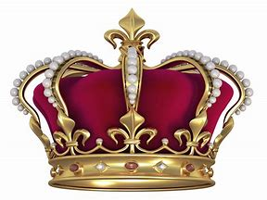
0’s
Zero is like a crown!
The king is the ruler and always wins!

Slide 3
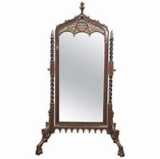
1’s
One is like a mirror. Whoever looks into number one sees itself!

Slide 4
2’s
Two’s always double the other number! Count by even numbers!

Slide 5
3
6
9
12
15 18 21
24 27 and
30 at last!

Slide 6
4
8
12
16
20 24
28 32
36 and
40!

Slide 7
10 15
25 30
40 45
50

Slide 8
6 12 18
24 30
36 42ooo
48
54!

Slide 9
7 14 21
28 35
42 49
56 and
63

Slide 10
8
16
24
32 40
48 56
64 72

Slide 11
9 18
27
36
45
54 63
72
81

Slide 12
20
40
60
80
90
100

Slide 13
22 33
44 55 66
77 88 99

Slide 14
12 24
36
48
60
72 84
96
108

